Slide 1
INTRODUCING…
SPORTS, LEISURE & PHYSICAL ACTIVITY
LMI CONFERENCE
JAN 2025

Slide 2
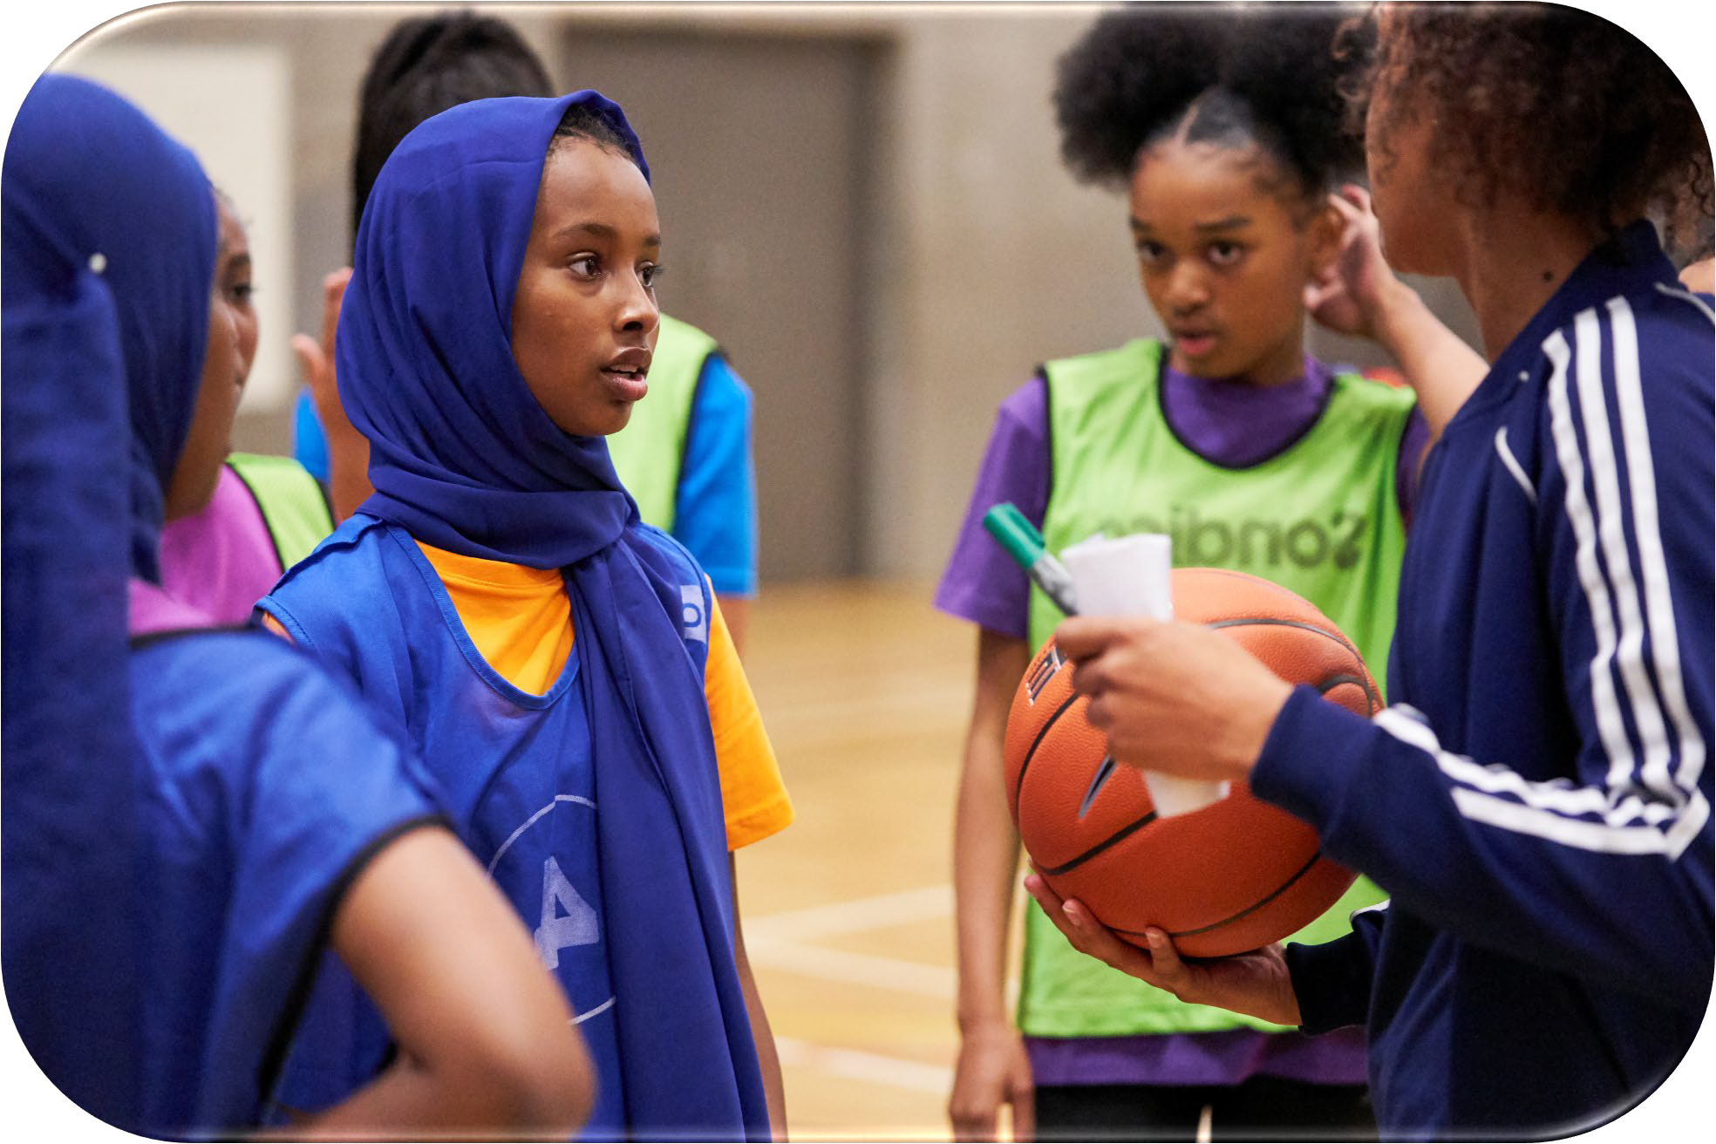
Transforming lives through the power of sport and physical activity and contributing to the health and well-being of the nation
A thriving country is an active country. Movement is the foundation of good health, wellbeing and thriving, sustainable communities.

Slide 3
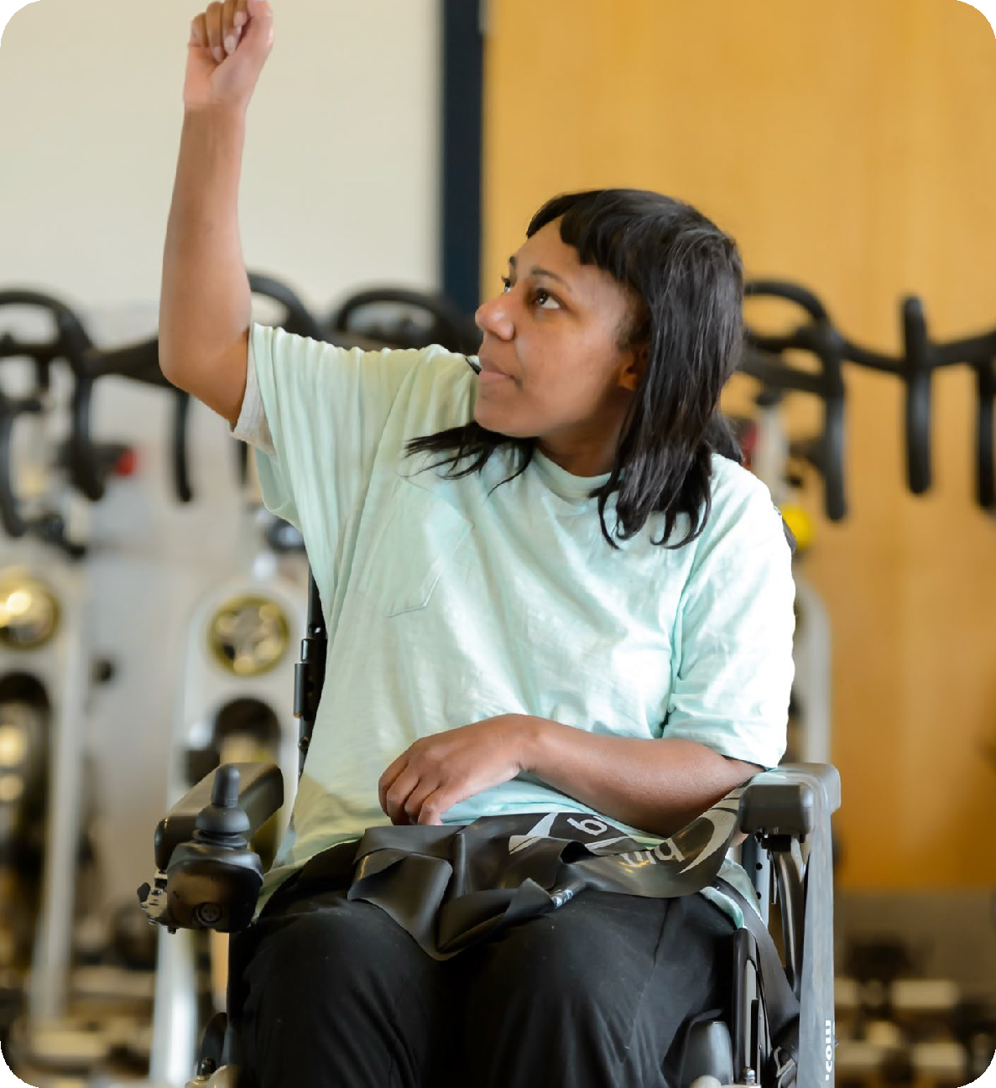
The Power of Sport and Physical Activity
Health & Wellbeing
Social Inclusion
Crime & Disorder Reduction
Covid Recovery
Community Cohesion
Climate Action / Net Zero
Regeneration & Economic Prosperity
Education Attainment
Employment & Skills
3

Slide 4
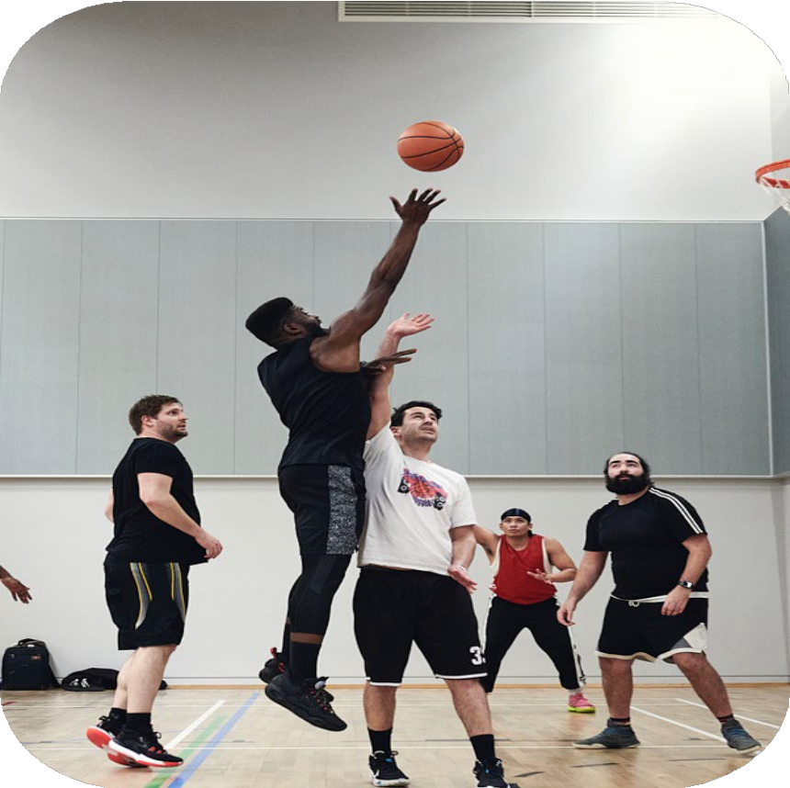
Value of the Sector
Over £107 billion in social value was generated in 2022/23 alone.
This figure represents both primary value - the wellbeing benefits that individuals experience from being active - and secondary value, which reflects the cost savings to public services like healthcare.
Source: https://www.sportengland.org/researc h-and-data/research/social-value- sport-and-physical-activity

Slide 5
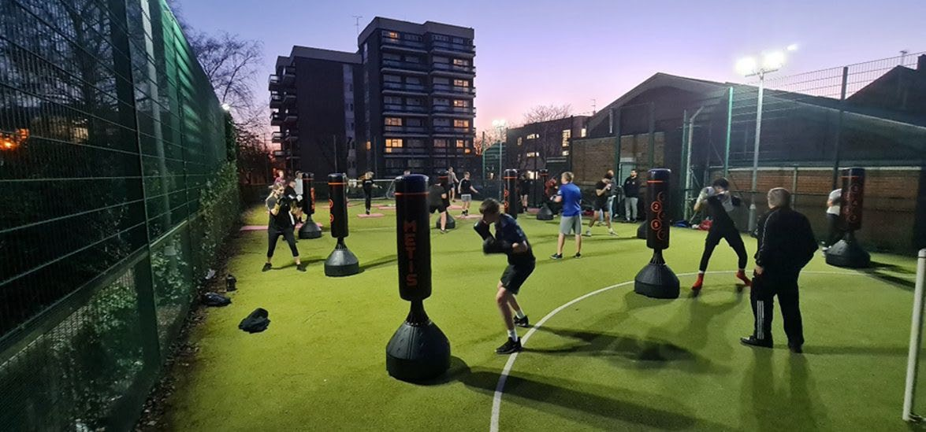
We need a diverse, skilled and welcoming workforce to achieve our mission: To transform lives through the power of sport and physical activity

Slide 6
Promotional Video
https://www.cimspa.co.uk/cimspa-careers-hub/

Slide 7
What is CIMSPA?
Chartered Institute for the Management of Sport and Physical Activity
The professional development body for the UK’s sport and physical activity sector, committed to supporting, developing and enabling professionals and organisations to succeed and, as a result, inspire our nation to become more active.

Slide 8
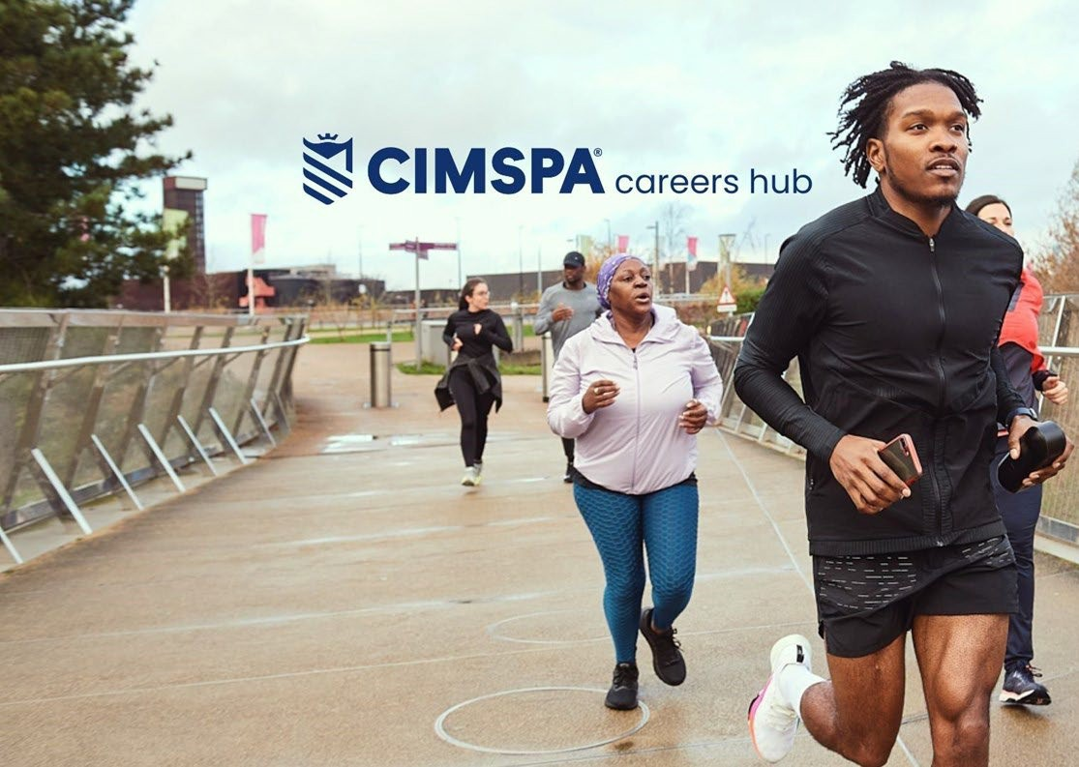
The CIMSPA
careers hub –
the place to go for career progression
The new and improved CIMSPA careers hub is now here and ready to help you thrive in a career in sport and physical activity. With information, resources and guidance to suit any stage you might be at, the careers hub is a wide-ranging toolkit.
Clear pathways
Changing direction
Your next move
https://www.cimspa.co.uk/cimspa-careers-hub/
Get recruitment ready

Slide 9
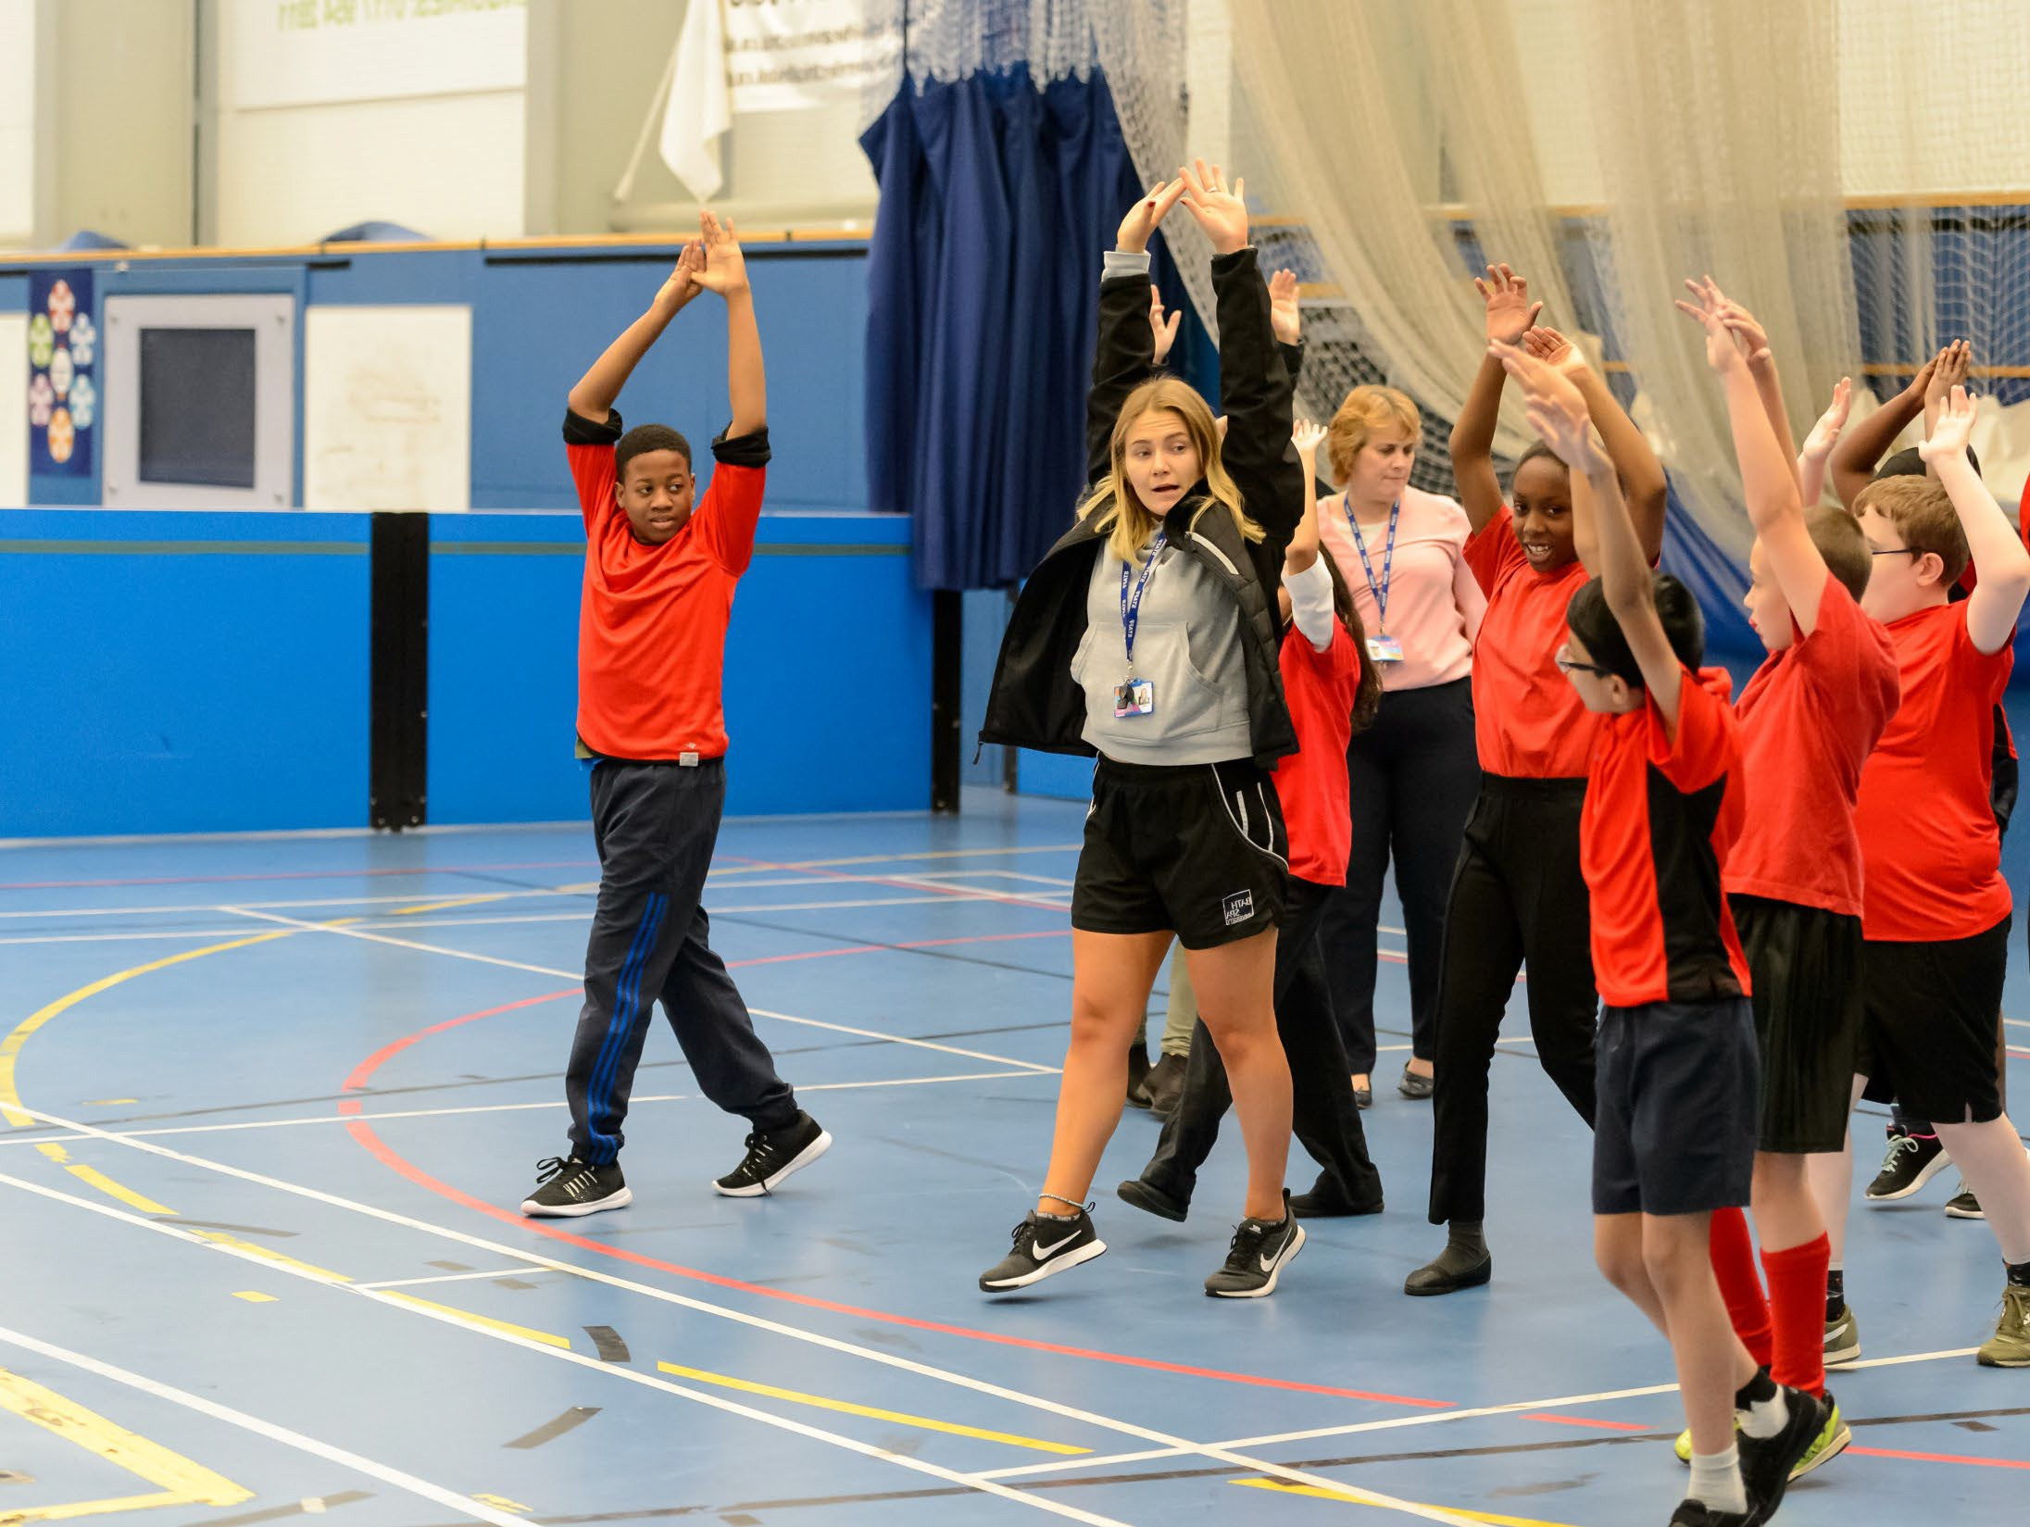
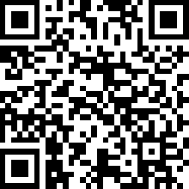
Careers guidance Sport and physical activity sector
Secondary School Package
Our bespoke set of educational resources are designed to instil knowledge, understanding and enthusiasm into learners who are interested in pursuing a successful career in the sector.
The Schools package includes: 1x 2-hour workshop about careers in the sector supported with workshop activity resources and a session plan, 1x assembly presentation about careers in the sector, a set of noticeboard resources and a leaflet to send home to parents/guardians.
CIMSPA Education contact: Micki Ruggins micki.ruggins@cimspa.co.uk
*Launching in January 2025, follow the QR code to submit your interest and join our waiting list.

Slide 10
Sector Industry definitions
Exercise and Fitness
Services, activities and venues that predominantly improve participant physical fitness.
Leisure Operations
Services, activities and venues that predominantly improve participation in physical activity.
Performance Sport
Competitive sport and activities in which athletes receive payment for their performance.
Health and Wellbeing
Holistic services and activities that promote improvements across all aspects of health, sometimes involving health care and other non-sector professionals.
Community Sport
Sport/skill-based services, activities and venues that increase participation and develop skill, sometimes targeting underrepresented groups and inequalities.
Adventure Sport
Activities, services and venues both indoor and outdoor improving participation in physical activity perceived as having a high level of risk.

Slide 11
Can you think of types of roles in each industry?
Exercise and Fitness
Personal Trainer
Group Exercise Instructor Fitness Manager
Leisure Operations Recreation/Leisure Assistant Swimming Teacher
Leisure Operations Manager
Performance Sport
High Performance Coach Strength and Conditioning Coach Sports Scientist
Health and Wellbeing
Exercise Referral
Health and Wellness Coach Social Prescriber
Community Sport
Sports Coach Coaching Assistant
Sports Development Manager
Adventure Sport
Multi Activity Outdoor Instructor Outdoor Leader or Guide Outdoor Youth Worker

Slide 12
What is the workforce size of the Sport and Physical Activity Sector is in the UK?
Paid employees only excluding volunteers 2023
586,000 423,000
222,000 1,267,000

Slide 13
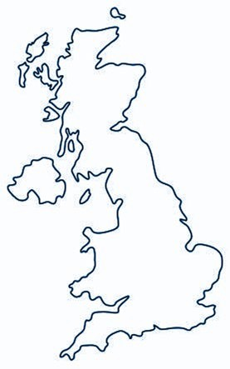
Businesses in the region: Companies
Hertfordshire
 |  | COMPANIES |  | EMPLOYEES |  | TURNOVER(£)
 |  | 990 |  | 24,889 |  | £1.05bn
 | Industry breakdown
 | Adventure Sport | 103 |  | 1,761
 | Community Sport | 45 |  | 222
 | Exercise and Fitness | 509 |  | 5,778
 | Health and Wellbeing | 246 |  | 16,897
 | Leisure Operations | 86 |  | 3,191
 | Performance Sport | 66 |  | 1,427
Whilst the 6 core S&PA industries are identified as being independent of each other, it is quite common for single venues or organisations to operate across multiple industries. Within Hertfordshire the data shows that 65 organisations operate across more than 1 S&PA industry. These organisations are only accounted for once in the overall number of S&PA organisations operating within Hertfordshire.
Hertfordshire

Slide 14
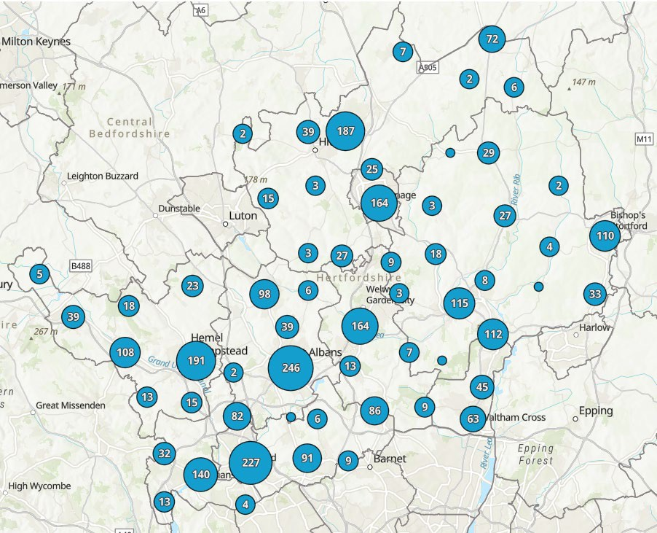
Facilities in Hertfordshire
Facility Type | No.
Artificial Grass Pitch | 145
Athletics | 12
Cycling | 7
Golf | 93
Grass Pitches | 1376
Health and Fitness Gym | 166
Ice Rinks | 1
Indoor Bowls | 8
Indoor Tennis Centre | 15
Outdoor Tennis Courts | 235
Ski Slopes | 4
Sports Hall | 297
Squash Courts | 44
Studio | 209
Swimming Pool | 130
Total Sites | 854
Total Facilities | 2742

Slide 15
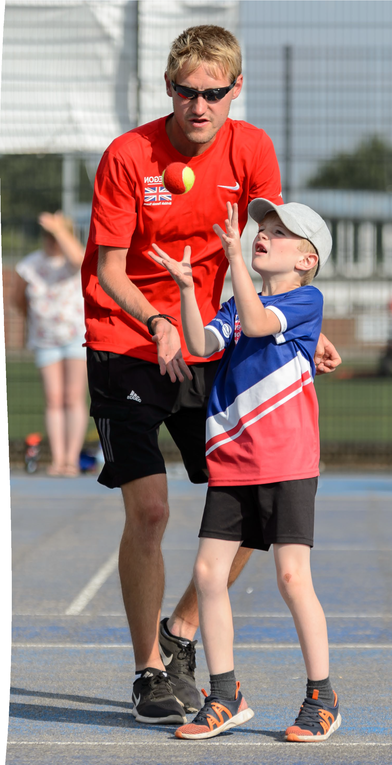
Landscape for Hertfordshire
12 School Sport Partnerships
Local Authorities 1/10/120
2 Universities
4 Further Education Colleges
60 School Facility Operators
Community and Voluntary Sector
Volunteers
Professional Sports Clubs
46 National Governing Bodies
2500+ Sports Clubs
Public Health Hertfordshire Integrated Care System
18+ Leisure Operators
23+ Coaching Agencies Our HSP Team

Slide 16
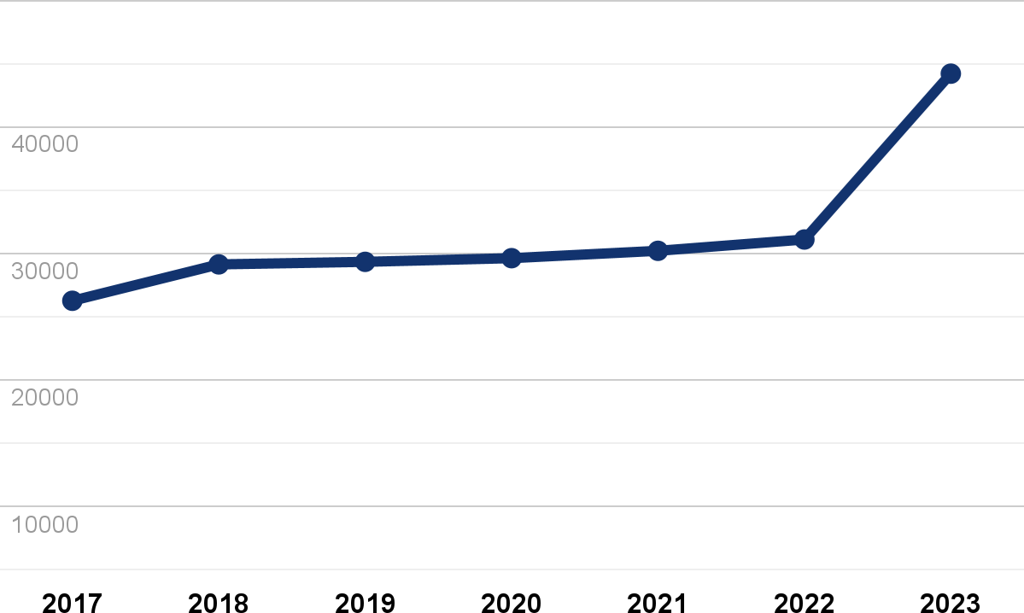
Businesses in the region: Growth
+6.5%
Estimated growth
The best estimate of the annual growth rate of the number of employees of all companies operating within the sport and physical activity sector, in Hertfordshire
Cumulative employee growth
There has been a growth in the size of the workforce employed by Hertfordshire’s S&PA sector of 17,926 since 2017, seeing a total increase of 68% in employees over the 6 year period. This shows growth across the sector, within the region and suggests that either new s&pa businesses have formed, or that existing S&PA businesses have expanded.
Hertfordshire

Slide 17
What percentage of the Sport and Physical Activity Sector is made up of 16–24-year-olds?
10%
20%
30%
CIMSPA Workforce Insight Report 2023
https://www.cimspa.co.uk/globalassets/document-downloads-library-all/insight/cimspa-workforce-insight- report-2023.pdf

Slide 18
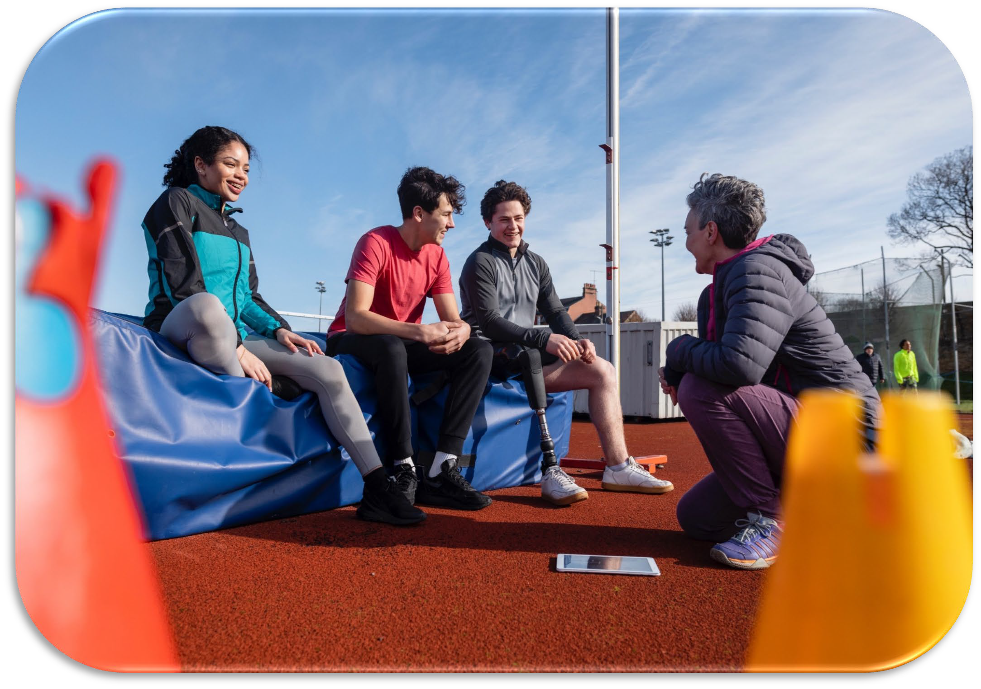
What is the top skill employers in the Sport and Physical Activity Sector look for?
Communication
Hertfordshire

Slide 19
Recruitment: Skills
Top 5 specialised skills
Top 5 common skills
Specialised skills are more tailored to the S&PA sector and typically include unique skills to S&PA job roles. Whereas, common skills are highly transferable skills, essential to many sector job roles. Over the last 12 months, ‘Sports Coaching’ has been the highest specialised skill desired by S&PA employers through job postings, appearing in 18% of job postings across Hertfordshire. Similarly, the top common skill over this period has been ‘Communication’.
Hertfordshire

Slide 20
LOVES
HIRING THE RIGHT PEOPLE

Slide 21
EVERYONE ACTIVE - HERTFORDSHIRE
Everyone Active currently operates over 20 leisure facilities within Hertfordshire covering:
Dacorum
East Herts
North Herts
St Albans
Stevenage
Three Rivers
Watford
This covers a multitude of facilities including:
Leisure Centres
Swimming Pools & Lidos
Golf courses
Theatres
Each of which require a multitude of staff to run on a daily basis.

Slide 22
Career Pathway - Apprenticeships
Apprenticeships help bring valuable skills into our workplace with the government's support.They’re suitable for people at any level so we can hire someone new or up skill an existing colleague.
An apprentice must:
be 16 or over & not already be in full-time education
be living in England
We can use apprenticeship training to:
fill key skill gaps in our business
boost colleague motivation by investing in their development & improve retention
There are apprenticeships from level 2 to level 7 (equivalent to a degree) so there are apprenticeships that suit the learning and development needs of our colleagues.
Apprentices need to work 30+ hours a week
Everyone Active partners with Lifetime, one of the leading training providers in the country to supply apprentice training to our colleagues as well as a number of specialist colleges for Golf and Spa training. Other colleges will be added as we develop the apprentice scheme

Slide 25
Career Pathways – General employment
Alongside apprenticeships Everyone Active also recruits for casual and part time hour positions in the aforementioned roles.
All opportunities with Everyone Active are promoted on Indeed, leisure opportunities and the centres social media sites.
Role hours will vary based on each individual contracts or sites needs.
Progression within the business is available for those who come on as part time or casual workers.
Those looking for work have to be 16 and have finished their education.

Slide 26
Career Pathways – General employment
Key Points:
Everyone Active is always looking for people to work.
Training & development is provided by Everyone Active, even with entry level jobs
Progression throughout the business is available for those willing to take the next step
Casual hour employment including Half Term Only work is also available
With over 250 sites across country we have ability to transfer colleagues across centres so should a colleague be moving or studying at a uni, there is potential for them to remain employed with Everyone Active

Slide 27
Please reach out to your local Everyone Active centre!

Slide 28
FE & HE offering sport related courses

Slide 29
School, FE & HE Sport Related Courses
GSCE / A Level PE
Active IQ Fitness & Sports Massage Level 1 Introductory Diploma in Sport
Level 2 Extended Certificate/Diploma in Sport
Level 3 Combined Diploma in Psychology with Sport
Level 3 Diploma/Extended Diploma in Sport – with football / exercise science
Active IQ Level 2 Certificate in Gym Instructing
HNC Community Coaching
Level 3 Diploma in Sports Massage
Level 3 Diploma in Sport, Fitness & Personal Training / Coaching & Development / Exercise Science
BSc (Hons) Sports Therapy BSc (Hons) Sports Coaching
BSc (Hons) Sport and Exercise Science
BSc (Hons) Sports Studies
BSc (Hons) Sports Business Management
MSc Strength, Conditioning and Rehabilitation

Slide 30
Transforming lives through the power of sport and physical activity and contributing to the health and well-being of the nation
A thriving country is an active country. Movement is the foundation of good health, wellbeing and thriving, sustainable communities.

Slide 31
Thank you

Slide 32
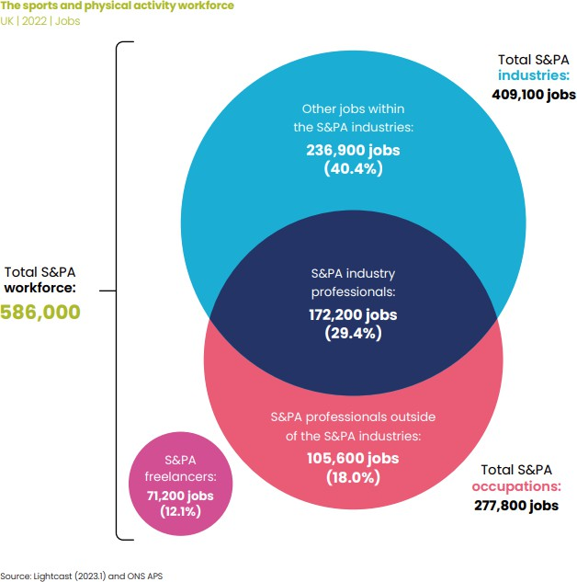
Changing skill composition
Rising demand for a broader range of skills, such as...
Human resources
Finance
Administration
Marketing and PR
Sales
Analysis
Customer and client support
Media and communications
Business

Slide 34
WORKFORCE - HERTFORDSHIRE
Current Next 12 Months
SENIOR MANAGER GENERAL MANAGER ENTRY MANAGER
OUTDOOR ACTIVITY ASSISTANT
HEALTH NAVIGATOR REC ASSISTANT
COACH ASSISTANT SPORTS COACH
POOL PLANT SW IMMING TEACHER
ASSISTANT SW IMMING TEACHER
LIFEGUARD YOGA AND PILATES INSTRUCTOR
STRENGTH AND CONDITIONING COACH EXERCISE REFERRAL INSTRUCTOR GROUP EXERCISE INSTRUCTOR
PERSONAL TRAINER GYM INSTRUCTOR
37 1
53
81
6
12
50
6
45
8
150
15
ROLES
20
222
26
101
254
27
72
10
29 2
14 3
271
13
85
7
114
10
NUMBER OF STAFF
This data was collected with 44 sport and physical activity employers from December 2023 - April 2024

Slide 35
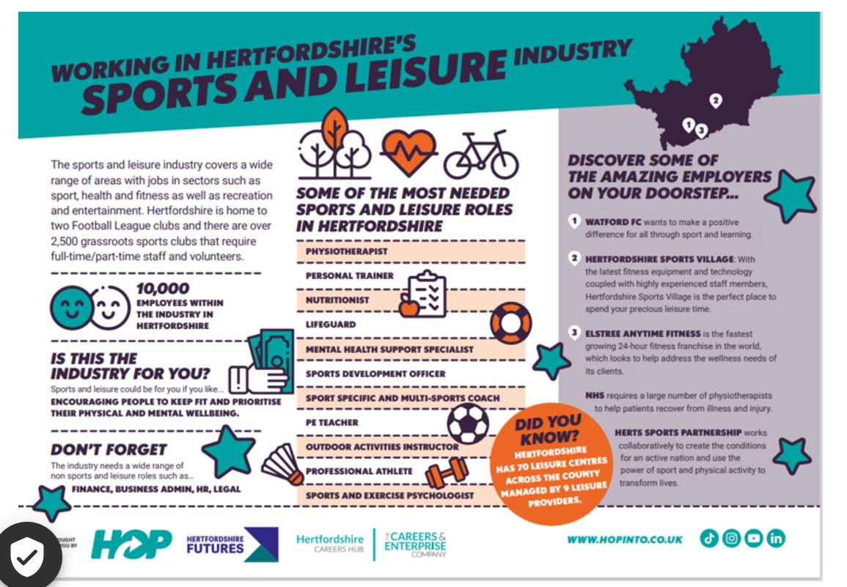
www.hopinto.co.uk

Slide 36
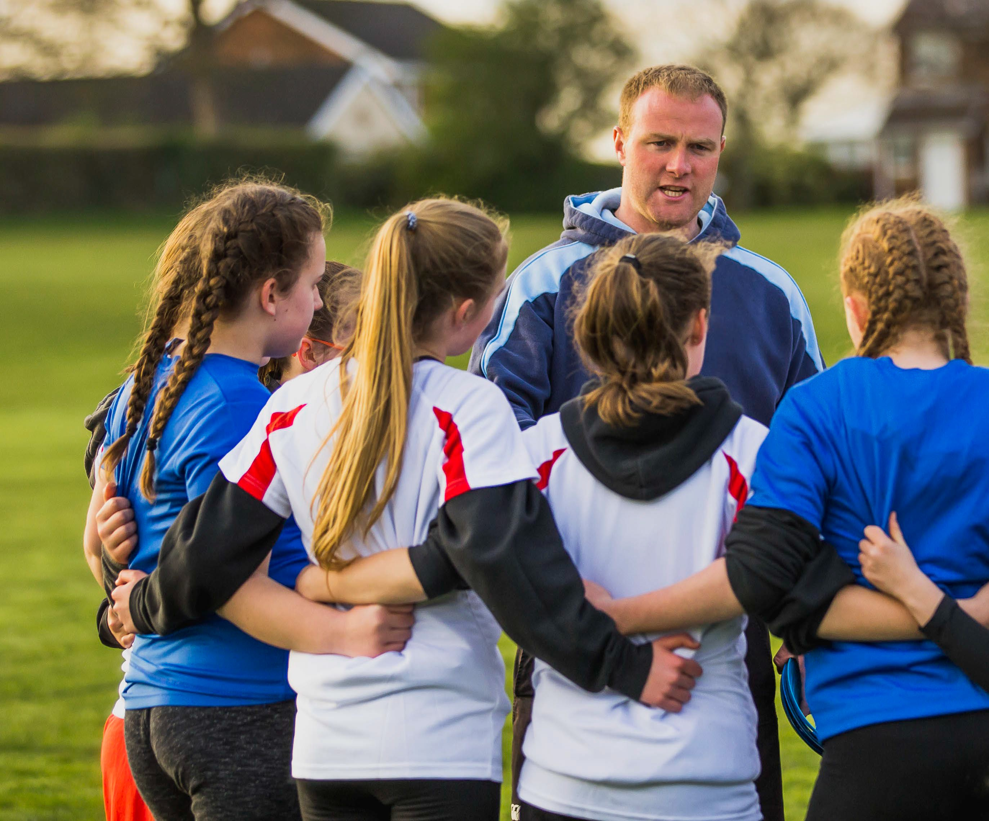
About CIMSPA
The Chartered Institute for the Management of Sport and Physical Activity (CIMSPA) is the professional development body for the UK’s sport and physical activity sector, committed to supporting, developing and enabling professionals and organisations to succeed and, as a result, inspire our nation to become more active.
VISION
Shaping a recognised, valued and inclusive sport and physical activity sector that everyone can be a part of.
VALUES
Our team values and culture are respect, quality and teamwork.

