Slide 1
INTRODUCING… LIFE SCIENCES
LMI CONFERENCE
JAN 2025

Slide 2
INTRODUCING…
Life Sciences
Nationally: The life sciences sector in the UK employees over 250,000 across more than 6,000 different businesses contributing to an estimated £70 Billion to the Country's Economy.
Hertfordshire is a significant hub for life sciences due to close proximity to London.
Pharmaceutical and Biotech:
The Pharmaceutical industry in the UK is a major component of life sciences with a strong growth of Biotech startups.
Pharmaceutical industry directly employs 73,000 people nationally.
Hertfordshire is a key region for pharmaceutical and biotech companies (Roche, GSK, Eisai etc.) and offers a vibrant job market.

Slide 3
DID YOU KNOW?
More than 65% of all medical research and development in the UK is carried out by the pharmaceutical industry.
Even at the start of the 21st century there are many diseases which cannot be cured by existing medicines and/or surgical treatments.
Discovery and development of new medicines, diagnostics and other therapeutic interventions are still very important!

Slide 4
DID YOU KNOW?
Careers in Life Sciences can be incredibly rewarding and provide a strong sense of purpose.
The UK life sciences sector is projected to face a shortfall of 133,000 skilled workers by 2030, so young talent is needed in this space.
However, the latest Science Education Tracker from the Royal Society and EngineeringUK, (supported by Wellcome), reported in over 7,000 secondary-aged young people, there was a decline in their engagement and aspirations in science since 2019.

Slide 5
Many Early Career Programs Are offered in Life Sciences To Attract New Talent !
01
Apprenticeships
02
Industrial Placements
03
Graduates
04
Research Fellowships
05
Summer Placements
06
Registrar Fellowships

Slide 6
ICEBREAKER
How much do you think Roche invested in R&D in 2022 (Swiss Francs)?
CHF 10 Billion
CHF 16 Billion
CHF 14.1 Billion
True Or False: - Roche employees over 103,000 employees world wide
Shout out how many tests have been conducted with Roche Diagnostic products in 2022?
How many Roche medicines are listed on the WHO Essential Medicines List?
15
23
32

Slide 7
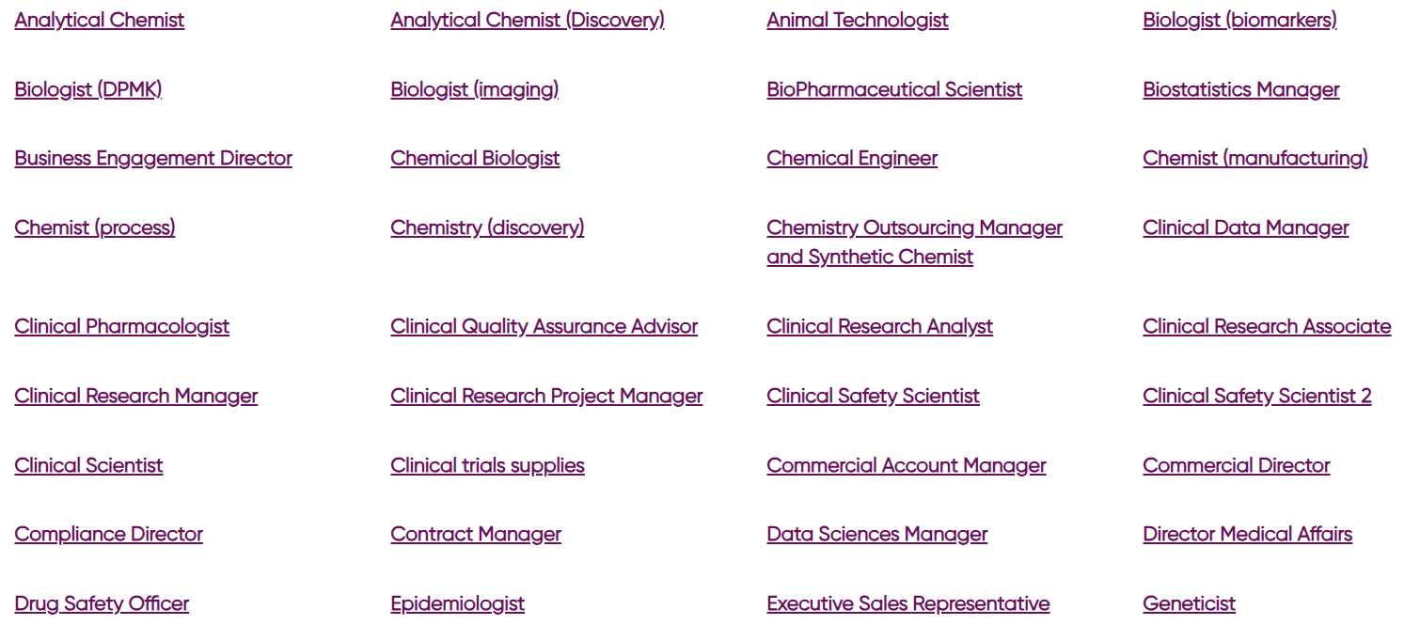
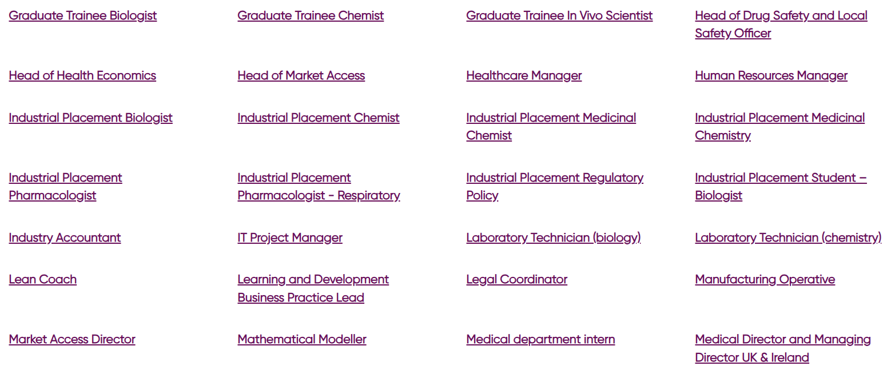
Huge Variety of Roles in Life Sciences!

Slide 8
Life Science Roles
Common roles in Life Sciences, Pharmaceuticals and Biotech:
Research Scientists
Clinical Researchers
Quality Assurance Specialists
Regulatory Affairs Managers
Biostatisticians
Lab Technicians
Data Scientists
Clinical Study Leads

Slide 9
Supporting Roles in Life Sciences
Other Roles:
Marketing
Resilience & Risk Management
Operations Partners
Environmental Health Officers
Physical & none Physical Security
Fire Fighters
Information Technology (including AI and Machine Learning)
Project Management
Legal
Change Management
Human Resources
Occupational Health
There are so many different types of roles and opportunities for growth and personal development within the life sciences and more specifically pharmaceuticals and Biotech, with many different pathways.

Slide 10
SKILLS AND QUALITIES REQUIRED
QUALIFICATIONS/
COURSES/ SUBJECTS
A solid academic background is crucial for many roles.
Most more specialist roles require at least a Bachelor’s degree in a relevant field.
Advanced degrees, such as a Master’s or Ph.D are often required or desirable for very specialised roles or research positions.
Experience can be helpful - internships, work experience programs, laboratory assistant positions etc. provide hands-on experience that is valuable when applying for jobs. Opportunities can be explored in university labs, research institutions, biotech companies.
Experience not only enhances a students CV but also helps to develop practical skills as well as professional connections which can be key!
Integrity: - We are consistently open, honest, ethical and genuine.
Courage: - We are entrepreneurial and thus take risks, reach beyond boundaries and experiment.
Passion: - We use our drive and commitment to energise, engage and inspire others.
By cultivating a culture of openness, we encourage everyone to grow their strengths, recognise and address weaknesses, and continually strive to accomplish ambitious goals we have set.

Slide 11
Case Study - What Do I Do?

Slide 12
Case Study - What Do I Do?

Slide 13
Let’s Hear A Real Life Example!

Slide 14
Let’s Hear A Real Life Example!

Slide 15
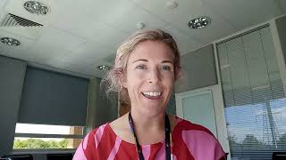
Let’s Hear A Real Life Example!

Slide 16
Where can I find more information?
Organisations such as the Association of the British Pharmaceutical Industry (ABPI) or BioIndustry Association (BIA) have a wealth of information on careers in this field and also interactive resources for schools available via their websites:
https://www.abpi.org.uk/
https://www.abpischools.org.uk/careers/
Platforms like LinkedIn are also very useful to find out further information from various organisations in the Life Science Sector.

Slide 18
GENERAL DISCUSSION Q&A

Slide 19
ANY FURTHER QUESTIONS?
CONTACT US:
Peter Johnson - BPM Leader at Roche
peter.johnson.pj5@roche.com
Clare Devlin - Associate Group Clinical Science Director at Roche
clare.devlin@roche.com

