Slide 1
INTRODUCING… BUSINESS, FINANCE & LEGAL
LMI CONFERENCE
JAN 2025

Slide 2
INTRODUCING…
Accountancy:
Public practice
Business
Corporate finance
Forensic accounting
Expert witness disputes
Tax (personal or corporate)
International
Law firms need;
Solicitors
Legal Executives
Paralegals
Accounts staff
Secretarial
Social media/marketing
Facilities management
IT support
Engineering/Defence:
Finance
Human Rescources
Sales and business development
Project managers
Commercial
Export managers

Slide 3
ICEBREAKER…ARE THESE STATEMENTS TRUE OR FALSE?
“Accountants must do maths at university”
“You have to be an Engineer to join an engineering firm”
“Accountants are boring and do not develop AI”
“You definitely need A Levels to join a Finance/Business related apprenticeship”
“Accountancy leads to a wide variety of international work”

Slide 4
OUR MOST IN-DEMAND ROLES
Always a need for qualified staff in all areas of work;
Paralegals
Support roles are increasingly important eg in social media, marketing,
“traditional” secretarial work on the decline
Accounting & Finance: All roles are in demand!
Accountants always needed (“recession proof”)
Businesses value accountants in finance and operational roles
Finance and Business Management Apprenticeships at MBDA

Slide 5
SKILLS AND QUALITIES REQUIRED
Accountancy
Degree route (Level 7 apprenticeship, 3 years, fully funded); or
School leaver (Level 4 apprenticeship, 5 years, fully funded).
Work full time, block study leave for college courses.
Technical study and non-technical (professional) skills.
Key attributes:
Enthusiasm for building strong relationships
Logical, enjoy problem solving
Commitment and a desire to learn
Proactive
MKS are recognised as one of the government’s Top 100 Apprenticeship Employers.
Legal
Degree (not necessarily in law)
Or
Without a degree;
1. Become a Chartered Legal Executive, or
2. Apprenticeship – 20% of working week spent studying and the rest working in a law firm. Lasts 5-6 years. Recommended entry requirements 5 GCSEs and 3 A levels
Then
1. Complete two years full time (or equivalent) qualifying work experience
2. Pass the SQE parts 1 and 2 whilst doing (1)
Key skills
- The Four “A’s”
- Good listener
- Attention to detail
Business/Finance (MBDA)
Level 3, Level 4 and Level 6 Apprenticeships
Suitable for all students no matter their academic achievements!
Key Attributes
Hard work
Love to ‘learn’ – not in the traditional sense
Get stuck in!

Slide 6
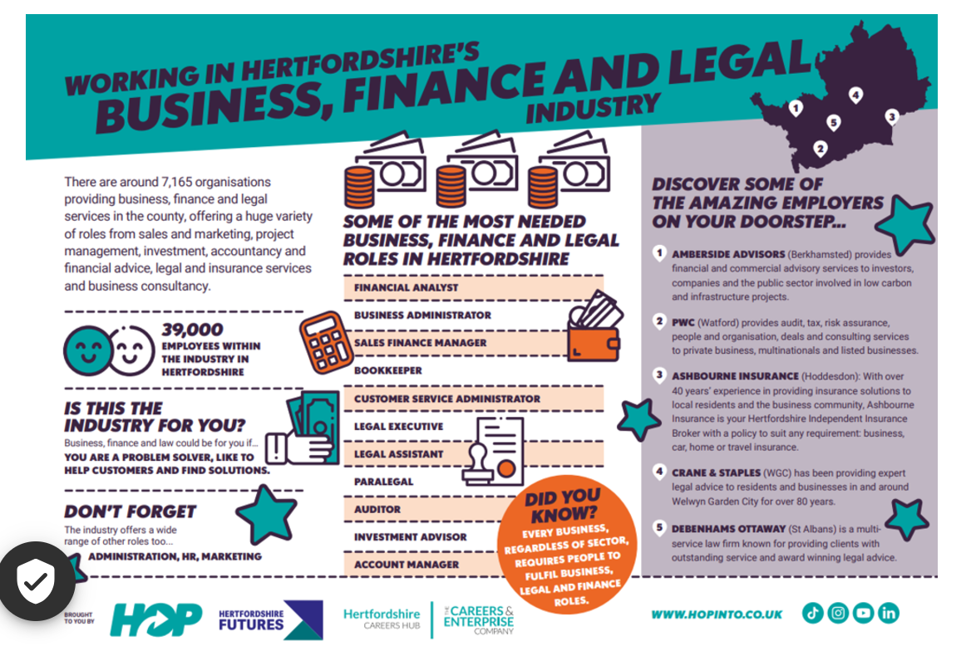

Slide 7
ANY QUESTIONS?
Michael Scutt – www.crane-staples.co.uk
https://www.lawsociety.org.uk/career-advice/becoming-a-solicitor/
https://www.lawsociety.org.uk/career-advice/law-students/essential-skills
Elsie Vivian – Early Careers Recruitment at MBDA

